Slide 1
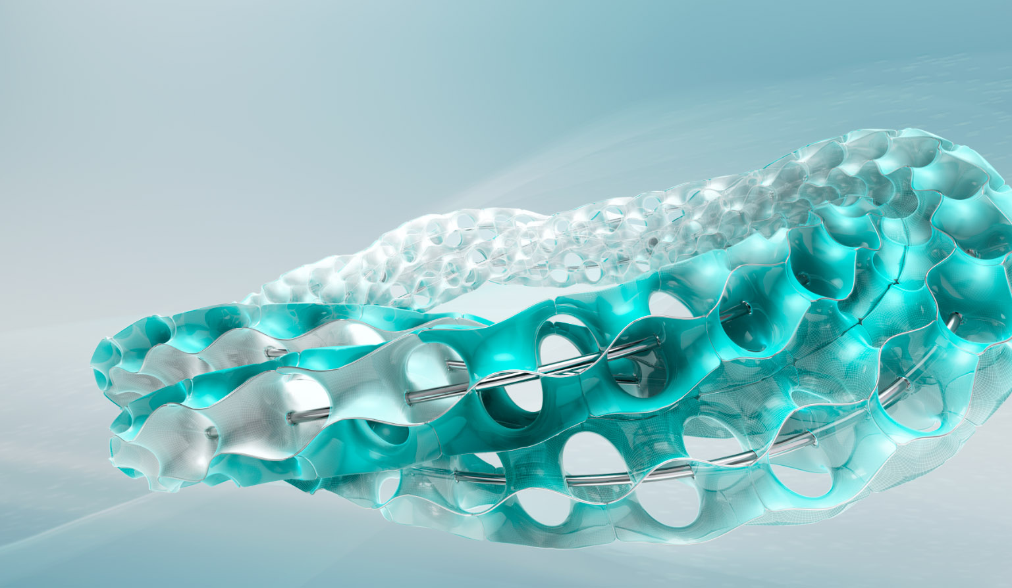


Admin Training
Using Autodesk Fusion Lifecycle

Slide 2
Welcome!
Internet Access
Browsers
Data Set
Copy Training Data Set to your desktop (or other accessible location!)
Notes:
E-mail Data Set or Pass around a USB Drive with Data Set

Slide 3
Training Approach
Module 1
Teach
(Slides)
Show
(Demo)
Do
(Exercises)
Review
(Q&A)
Module Overview
Uses
Alternate Uses
Concepts
Live Demo
Just watch, don’t try to click along
Hands on Exercises
10-20 minutes
Review concepts
Q&A

Slide 4
Learning Objectives Using Fusion Lifecycle
Teach
(Slides)
Show
(Demo)
Do
(Exercises)
Review
(Q&A)
Signing In
Menus
Workspaces
Navigation Tips
Workflow
Home Screen Areas
Using Reports

Slide 5
Teach
(Slides)
Show
(Demo)
Do
(Exercises)
Review
(Q&A)
Teach
(Slides)
Show
(Demo)
Do
(Exercises)
Review
(Q&A)

Slide 6
Teach
(Slides)
Show
(Demo)
Do
(Exercises)
Review
(Q&A)

Slide 7
Exercises 1 - 5
Teach
(Slides)
Show
(Demo)
Do
(Exercises)
Review
(Q&A)
03 Admin Training

Slide 8
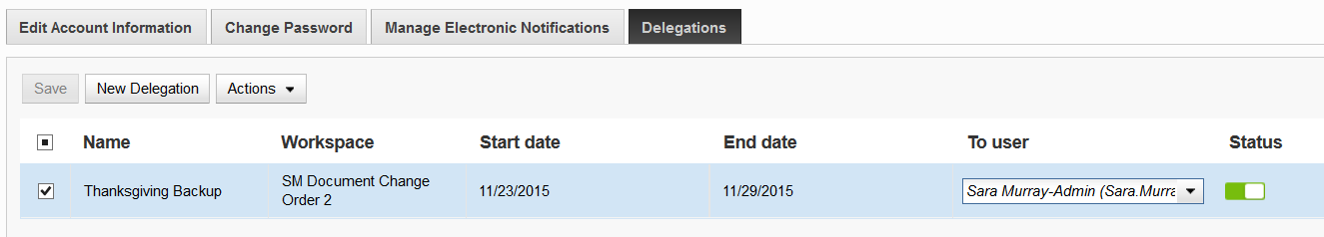
End User Delegation
Set up a delegation from your user to another
Workflow history shows “On behalf of” yourself
Tips
Double-click to pop open the drop down lists
Turn an existing delegation off or on simply by clicking on the Status switch
“Set” the new delegation by clicking off of it, then click the Save button
Even after saving, you will be asked if you want to leave page; yes it’s OK

Slide 9
Teach
(Slides)
Show
(Demo)
Do
(Exercises)
Review
(Q&A)

Slide 10
Exercises 6 - 9
Teach
(Slides)
Show
(Demo)
Do
(Exercises)
Review
(Q&A)
03 Admin Training

Slide 11
Review Using Fusion Lifecycle
Teach
(Slides)
Show
(Demo)
Do
(Exercises)
Review
(Q&A)
Signing In
Menus
Workspaces
Navigation Tips
Workflow
Home Screen Areas
Using Reports

